Slide 1
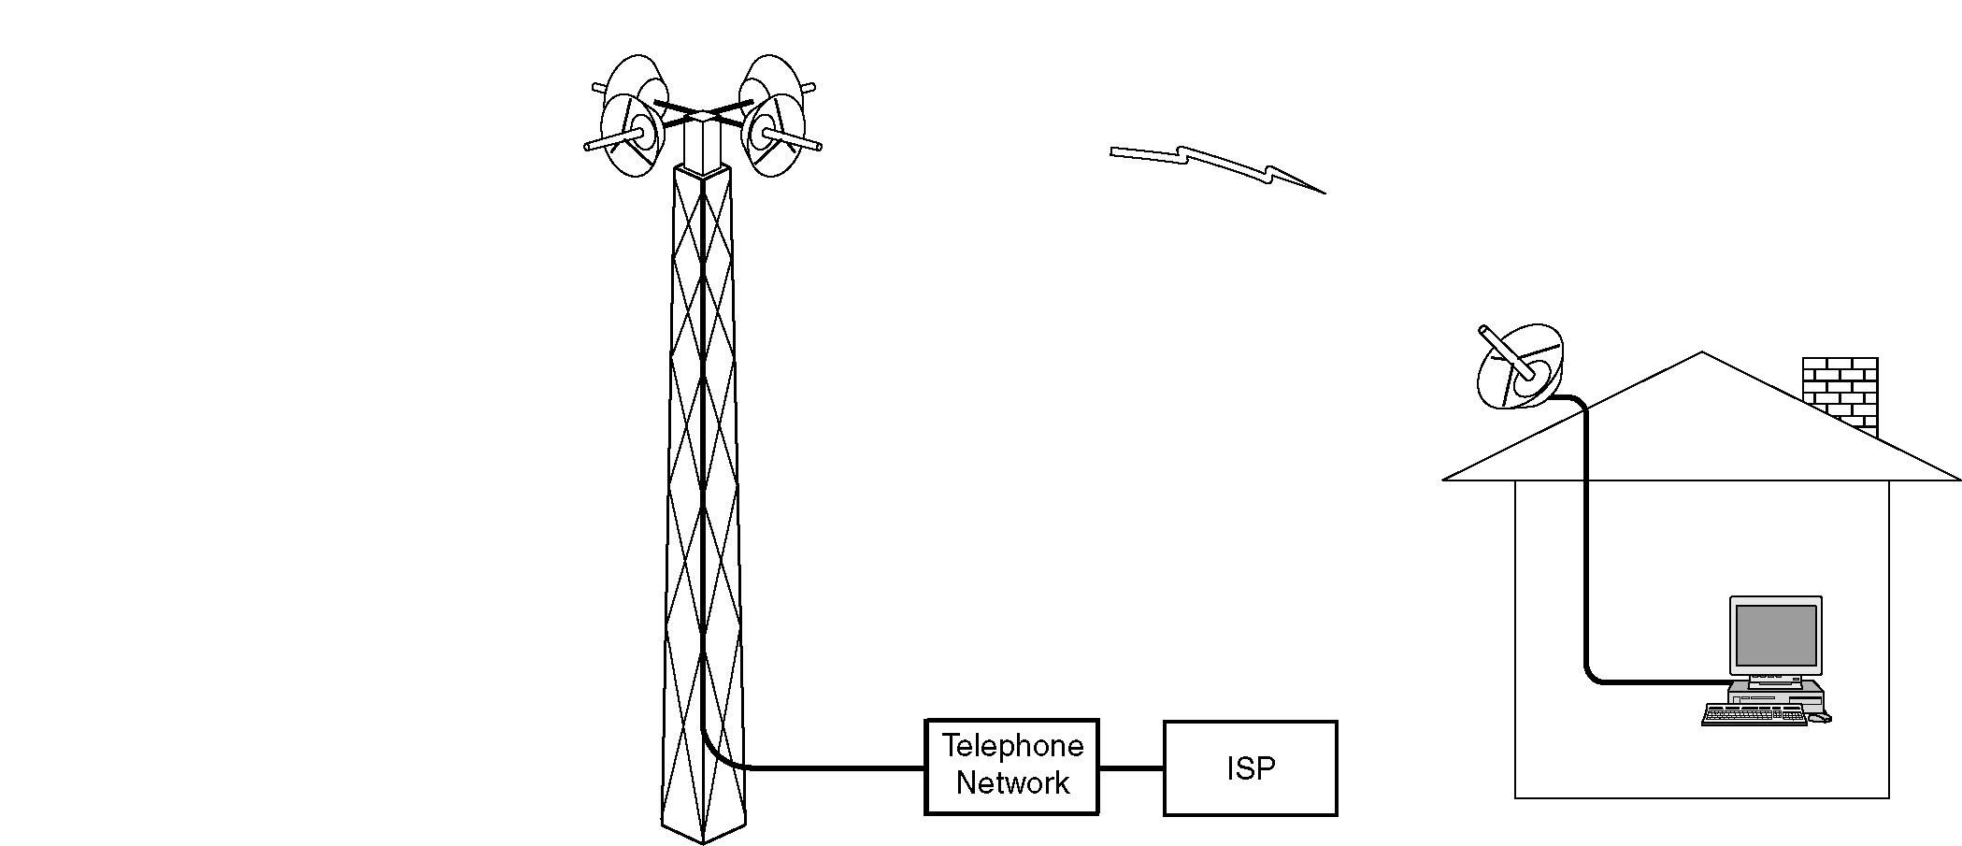
Example of Wireless Local Loop
Local Multipoint Distribution System

Slide 2
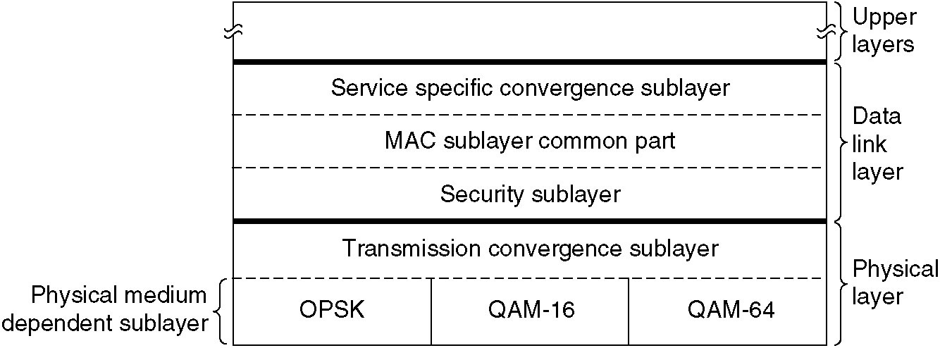
802.16 Protocol Stack
Similar to other 802 networks with more sublayers
Bottom layer deals with transmission
  Convergence sublayer hides different technologies from data link layer

Slide 3
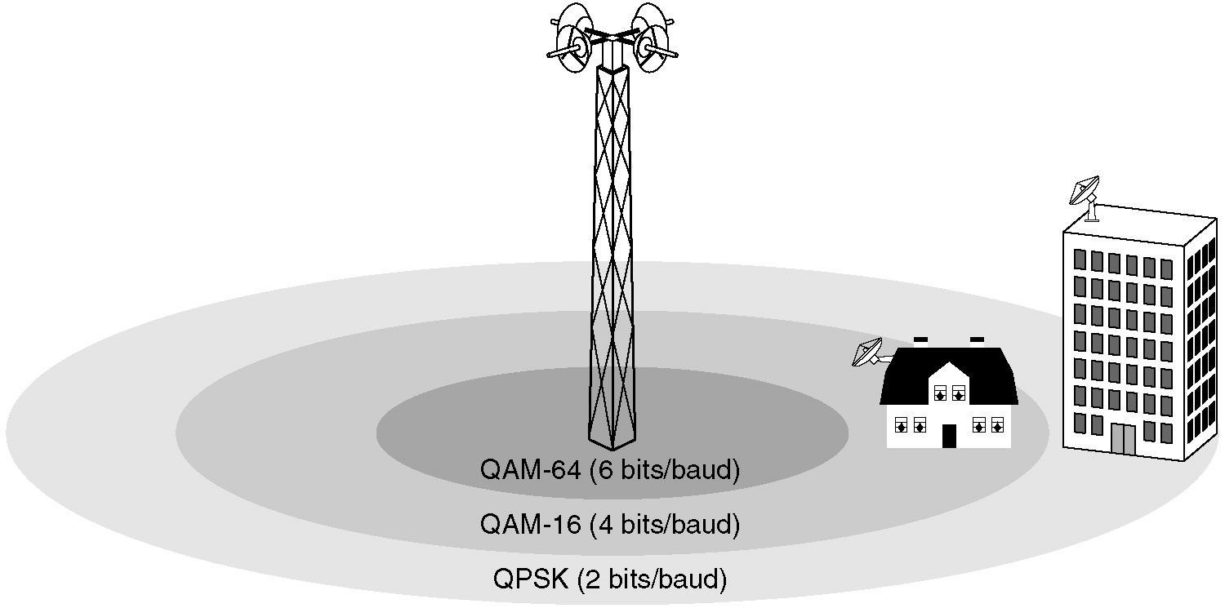
802.16 Physical Layer
802.16 transmission environment

Slide 4
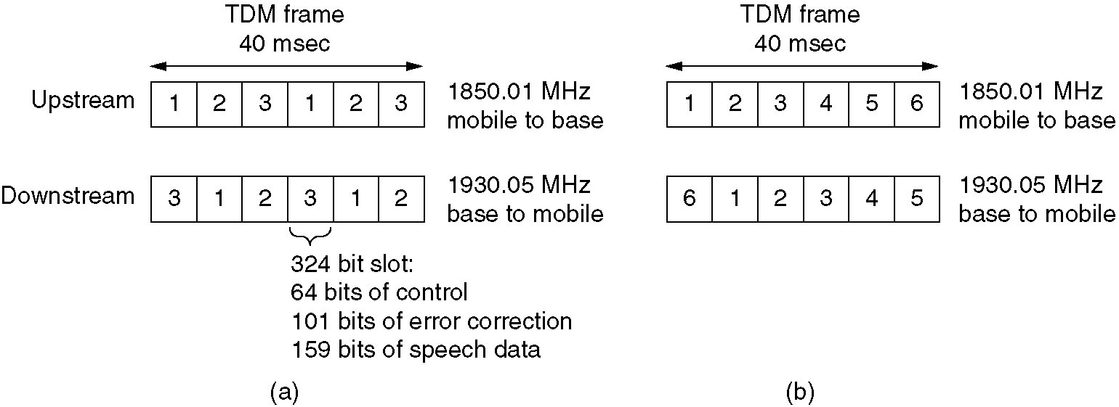
Frequency Division Duplexing Example
(a) A D-AMPS channel with three users.
(b) A D-AMPS channel with six users.

Slide 5
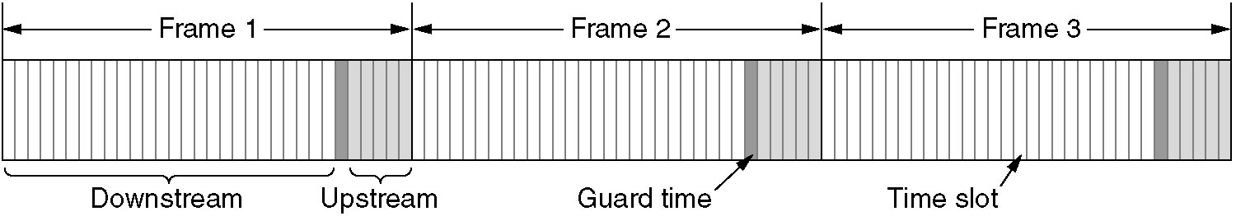
Time Division Duplexing (TDD)

Slide 6
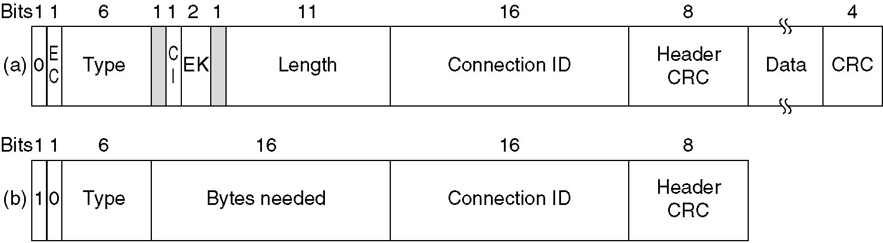
802.16 MAC Frame Layout
Generic Header
Bandwidth Header

Slide 7
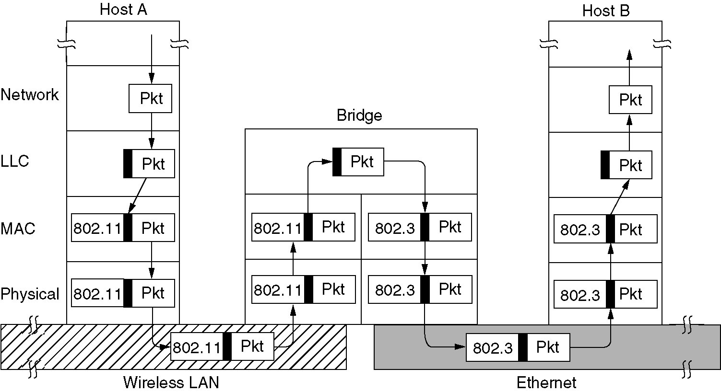
Bridges from 802.x to 802.y
Example of a LAN bridge from 802.11 to 802.3

Slide 8
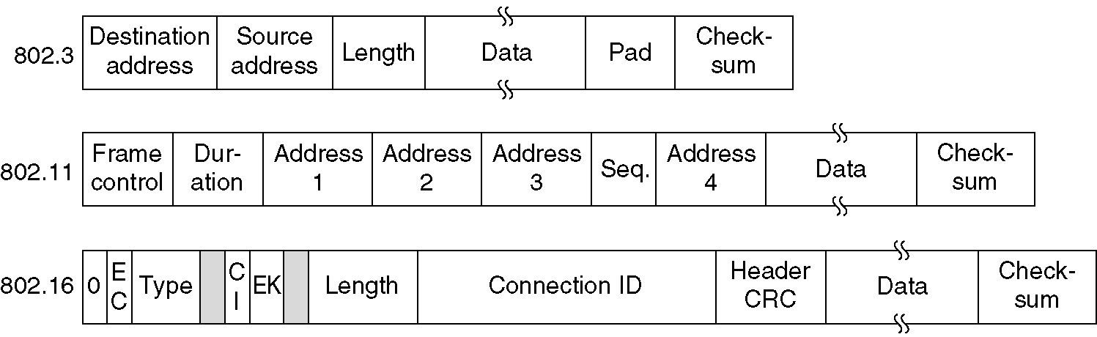
Frame Format Differences between 802 LANs

Slide 9

Overview of Store-and-Forward Packet Switching

Slide 10

Datagram Subnet Operation
Given that process P1 on H1 has a long message for P2 on H2
  Assume that message is 4 times longer than maximum packet size (4 packets-1, 2, 3, 4)
Routing within a diagram subnet.

